Slide 1

BETA Release

Slide 2

Agenda
INTRODUCTION
PROCESS
ACHEIMENTS
TEAM
WHAT’S NEXT
CLOSING

Slide 3

INTRODUCTION
STORY BEHIND THE POSTMEN
Does your chat application really protect your data?
Feeling of insecurity becomes the major issue in todays’ communication. Even the most famous applications fail their target to provide a secured connection between the users. Not that they are unable to provide so, but they trade user details with other companies. POSTMEN is a best way to secure your personality.
DATA IS THE MOST POWERFUL WEAPON FOR TODAY

Slide 4

INTRODUCTION
STORY BEHIND THE POSTMEN
Does your chat application worth to control your business connections?
You can be developer, or a manager to some department, or even an entrepreneur who owns a company which needs business connections in a more secured and a standard way. All the social media we experience now are not suitable platforms to have such valuable business connections. Even at the busiest moments POSTMEN will be your reliable partner which connects you to your solutions that spread all over the world in seconds.
DATA IS THE MOST POWERFUL WEAPON FOR TODAY

Slide 5

INTRODUCTION
STORY BEHIND THE POSTMEN
Does your chat application make you feel more closer to ones you love?
Rainy days makes us feel distressful because of poor signal issues makes the communication with distance ones more annoying. Even though people could chat with some one, the application which could bear any signal strength is not very interesting. No one would like to use chat apps with basic features nowadays. POSTMEN will bring you the experience of future today.
FEATURED APPLICATION WITH HIGH PERFORMANCE
IS THE WINNER

Slide 6

How postmen born
Let’s Dive In

Slide 7

How postmen born
CHAT APPLICATION
With maximum security and advanced features suitable for your business
BETA RELASE IN 2 MONTHS
Plan was to have a rapid development with prototype.
FLUTTER AS SDK
POSTEMN is a cross-platform software developed in Dart.
FIREBASE AS THE PLATFORM
With this we applied real time database, cloud storage, authentication, crash reporting, machine learning, remote configuration, and hosting for our static files.

Slide 8

Postmen features
Real time text transmission
Flexible and reliable steps
Unlimited cloud storage
End-to-end encryption
Google account authentication
In app notifications, push notifications
Unlimited concurrent chats
Customize chat features
Animated stickers
File sharing

Slide 9

what we achieve
LOOKING AHEAD

Slide 10
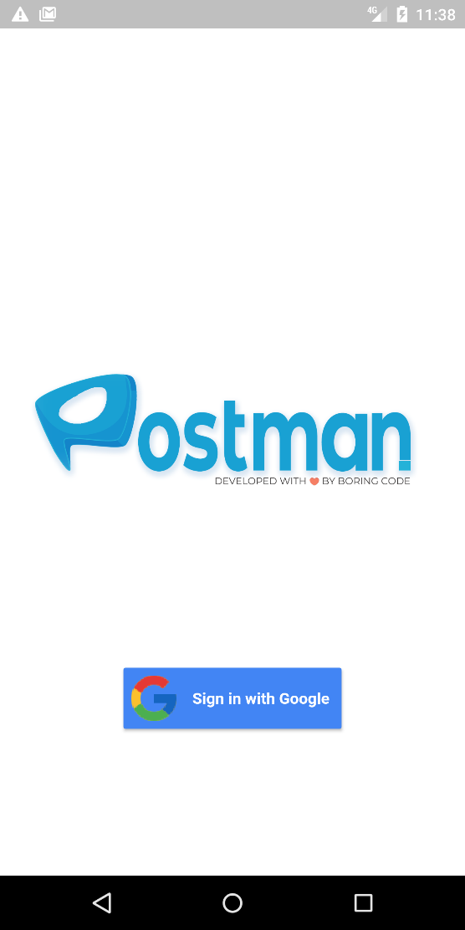
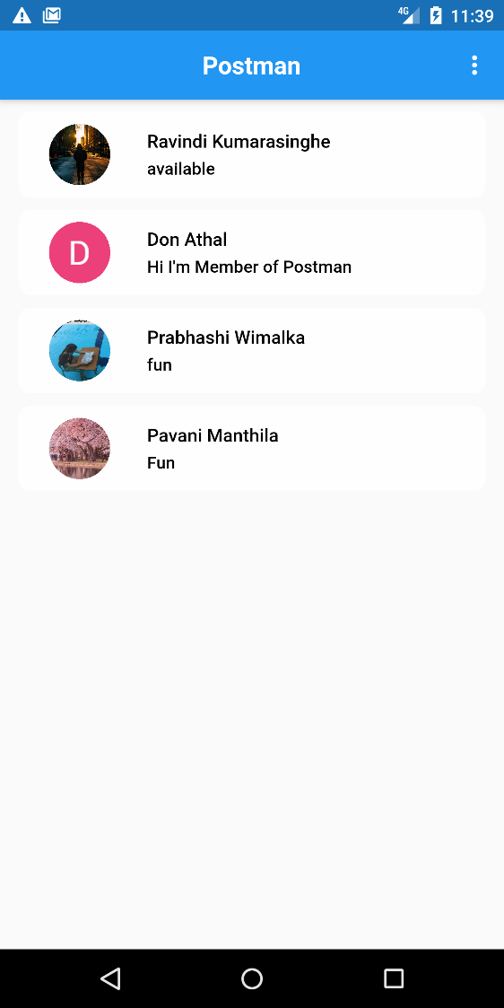
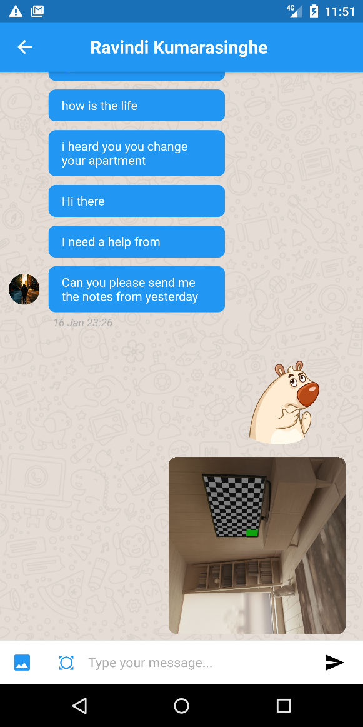
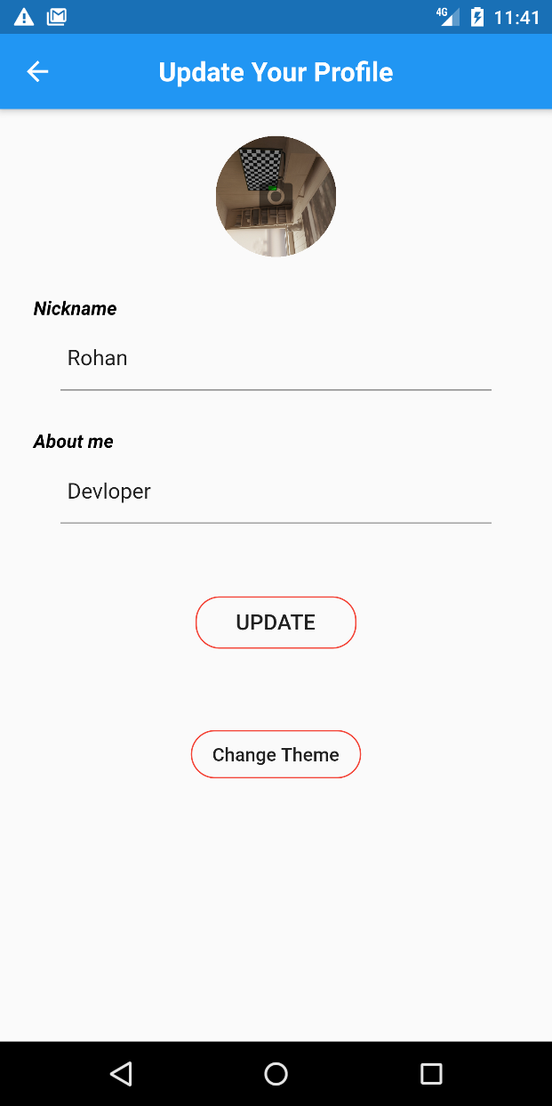
Light mode

Slide 11
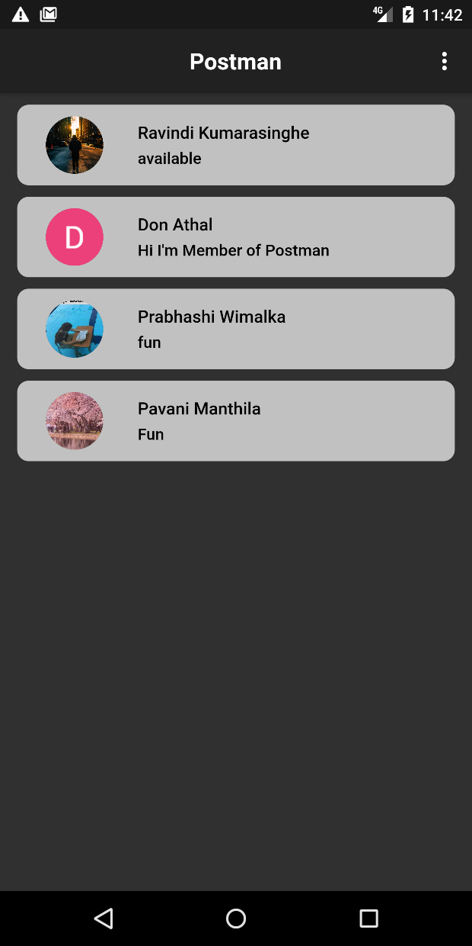
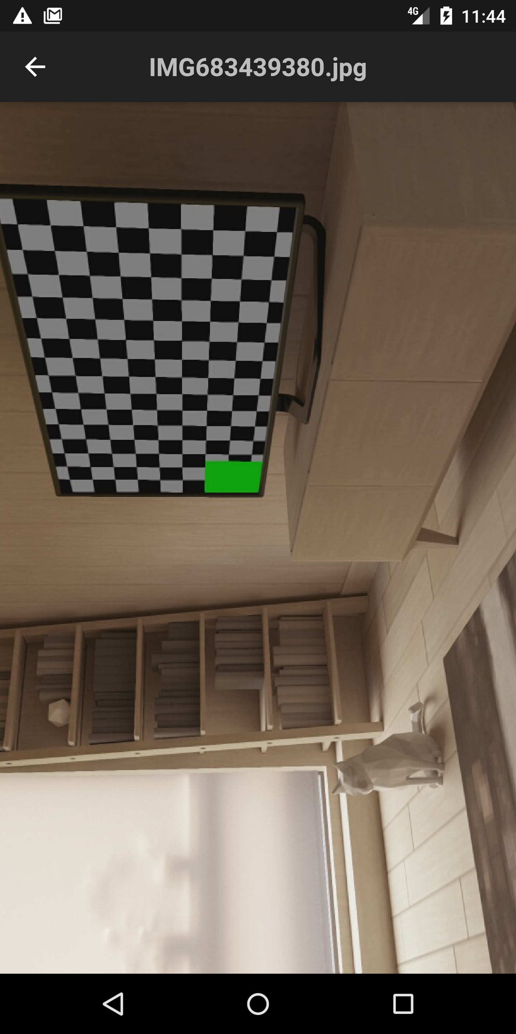
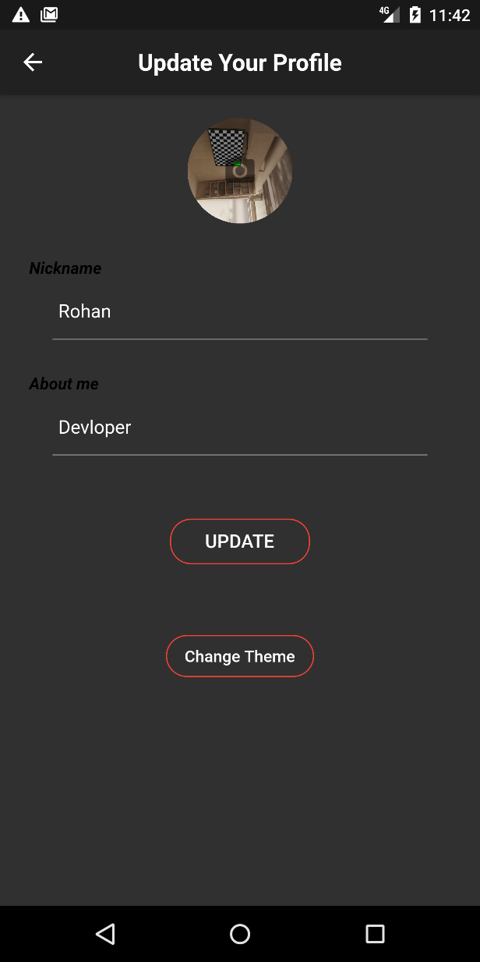
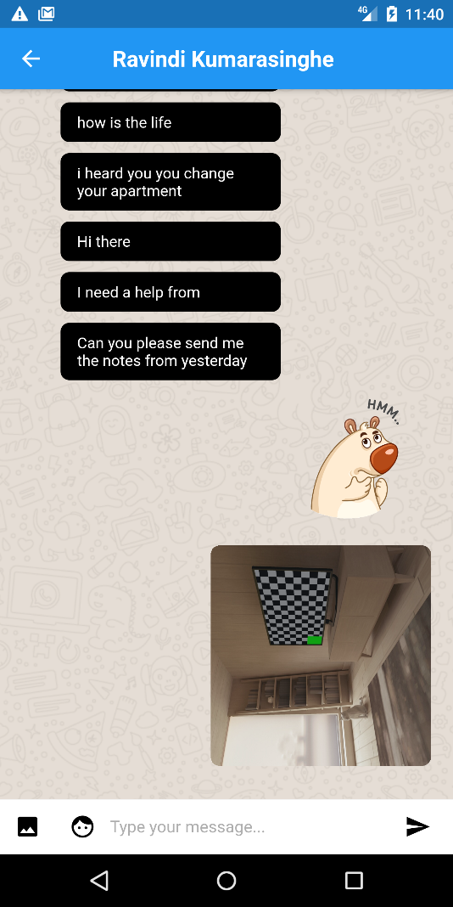
dark mode

Slide 12
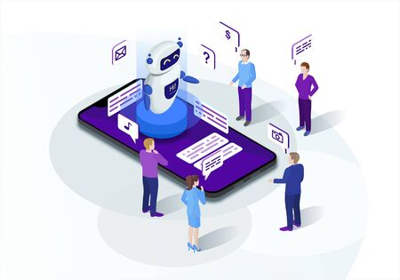
future we see
What will be the next

Slide 13

Our ultimate goals
Live streaming
Automated and AI powered Chat bot
Geolocation data sharing
Full Transparency Analytics of usage
Unlimited file sharing
Block spam, message filtering
Unlimited group member chats
High quality secured video calls and group calls
Introducing web application
Premium features at affordable price.

Slide 14
MEET THE TEAM
Team leader
Rohan K. Herath
Team members
Chathiru D. Liyanage
Ravindi Kumarasinghe
Prabhashi D. Hettiarachchi
Iresha D. Gallage
Pavani Manthila

Slide 15




THANK YOU
TEAM LEADER
H.M.R.K. HERATH
+94 777 65 61 77
hmrohankumara@gmail.com
LET THE CODE CHANGE YOU

